Slide 1
bugbusters presentation

Slide 2
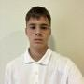
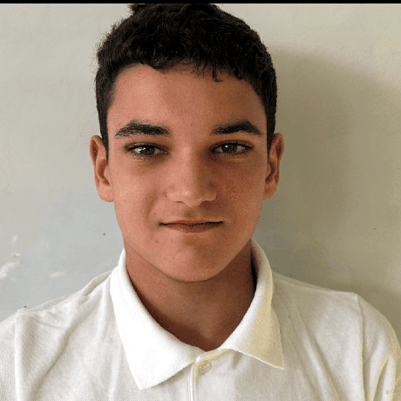
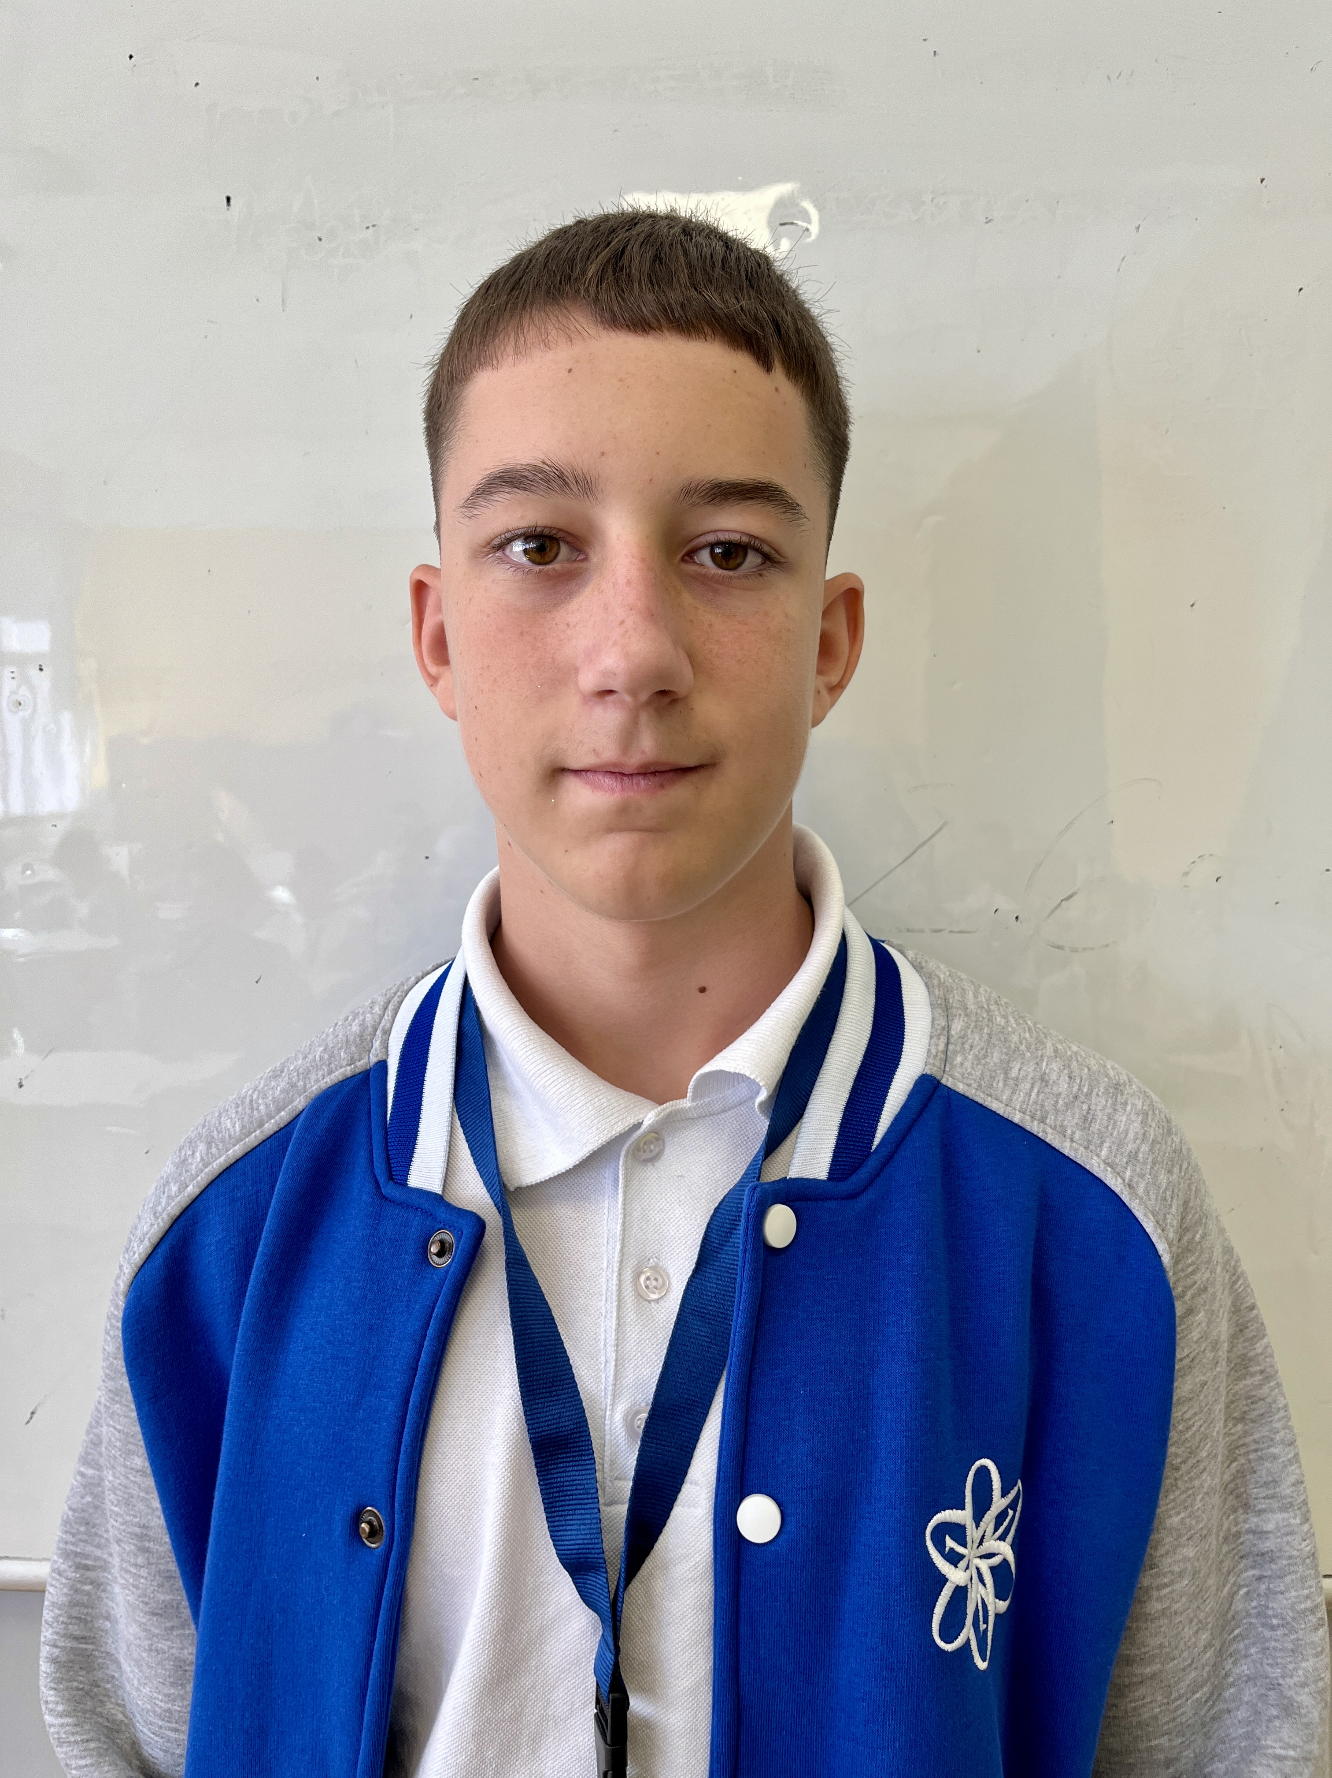
Our team
Scrum Trainer – Hristiyan Mihaylov
Front-end developer – Georgi Gakev
Back-end developer – Yanislav Todorov

Slide 3





Used applications

Slide 4
Presenting the project

